Slide 1
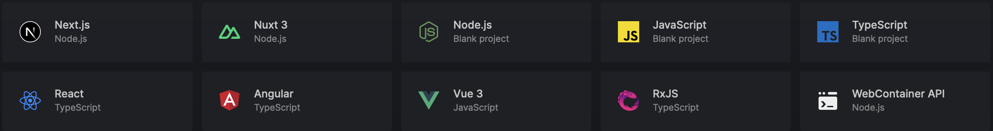

Notes:
In the developer community, it is common to see new frameworks and tools appear every day. Some of them offer a different approach to solving scenarios that are currently being solved with other tools. Others bring a new concept or idea, proposing a different way to face the projects.

Slide 2

Notes:
As the chef has types of knives to cut through different foods, developers have many available frameworks and libraries that are a good fit for different use cases.

Slide 3

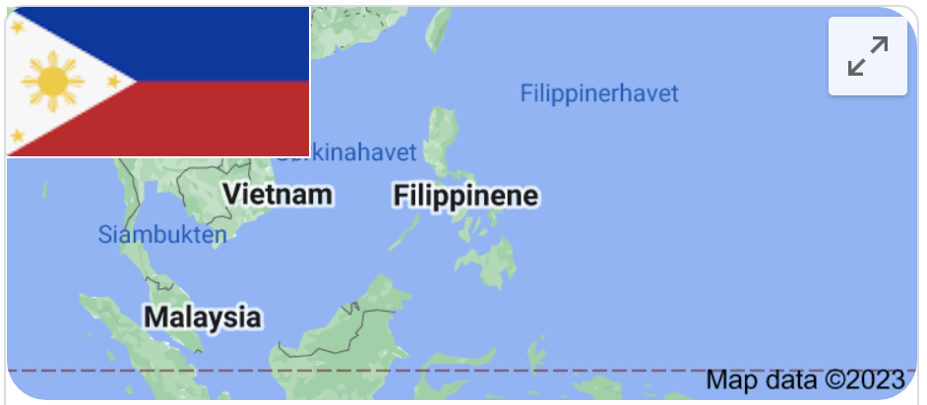



Slide 4


Slide 5

Devlin Duldulao
Notes:
and I am here to talk about Remix, a web framework to create JavaScript projects using server-side rendering. Let’s go through its main features and concepts and see the similarities and differences with another popular JavaScript framework: NEXT.js

Slide 6
Progressive Enhancement
Notes:
First in the list is progressive enhancement. For everyone to access the basic content and functionality of your web app in any browser or internet connection but also gives a better version of the app if your users are using advanced browser or better bandwidth in the internet connection. Things will work if users interact with a functionality, for example a Link, even javascript is not yet fully downloaded. It’s like switching to MPA from SPA automatically if it has to.

Slide 7
Progressive Enhancement
Basic user experience
Browsers compatibility
Faster and stable
Accessibility friendly
Notes:
This progressive enhancement gives us basic user experience and cross compatibility across browsers to ensure stability. In short, you have a faster web app and accessibility friendly web app out of the box.

Slide 8
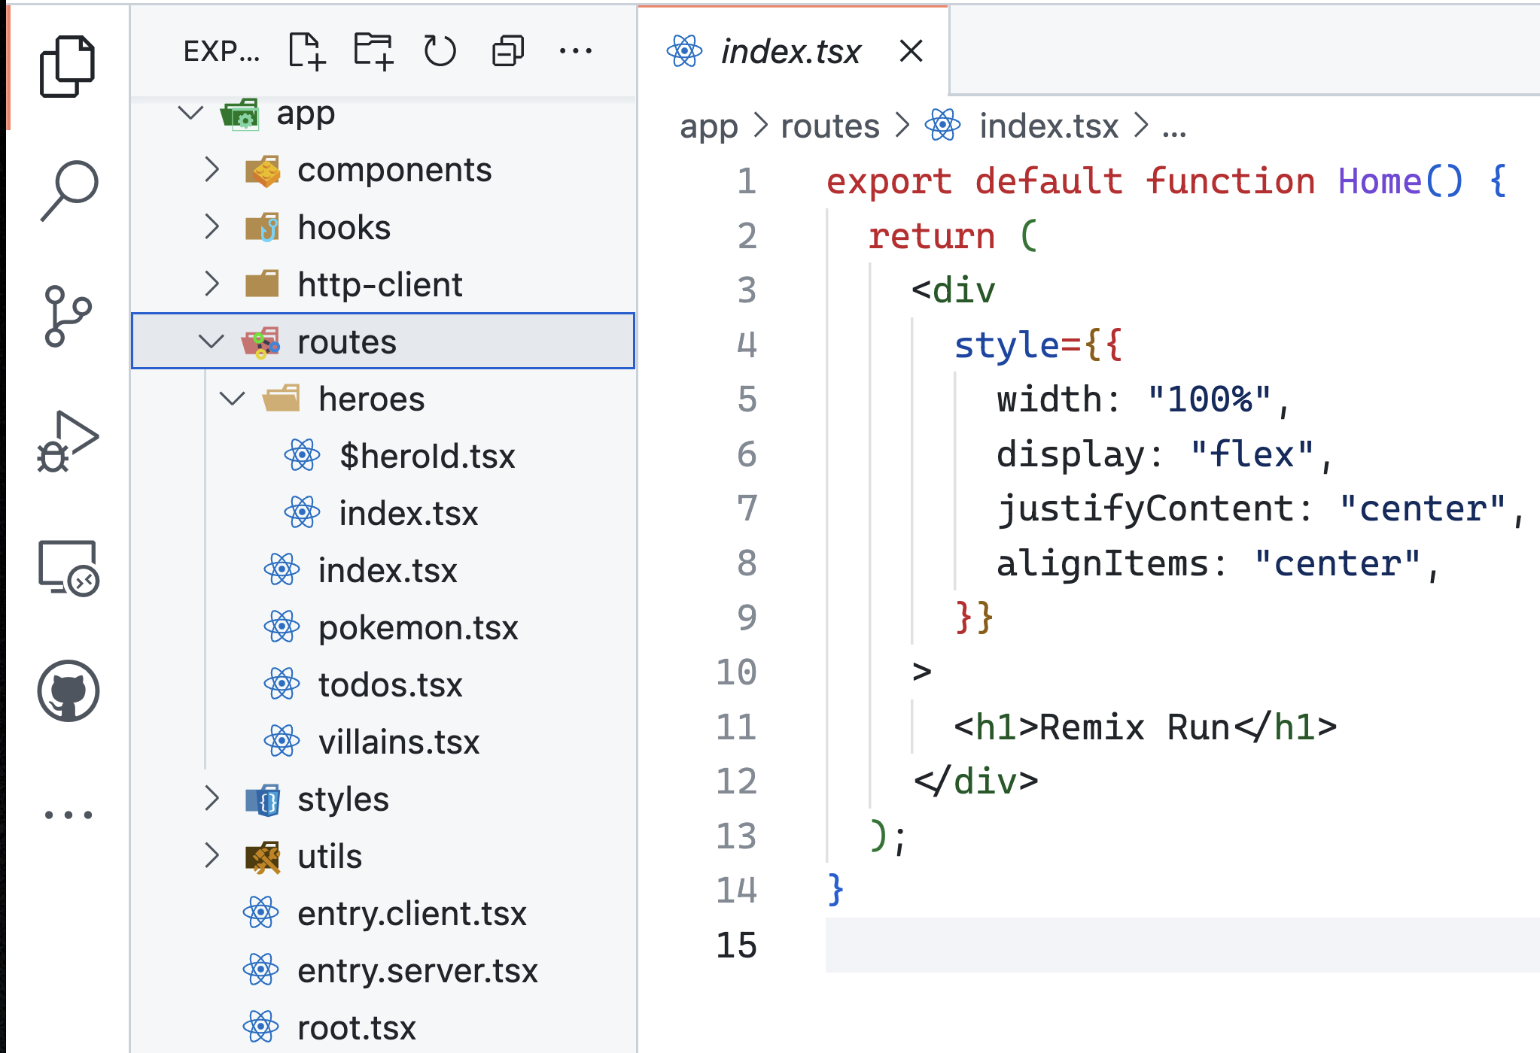
Routes
Notes:
Routes. Like other frameworks, Remix allows developers to manage the different routes of their web projects using JavaScript/TypeScript files that contain handler functions. File-based routing system out of the box. No setting up of routing like in SPAs.

Slide 9
React-Router
Notes:
Remix routes work using the partial routing feature provided by React-Router. With this approach in mind, we can highlight the following benefits.

Slide 10
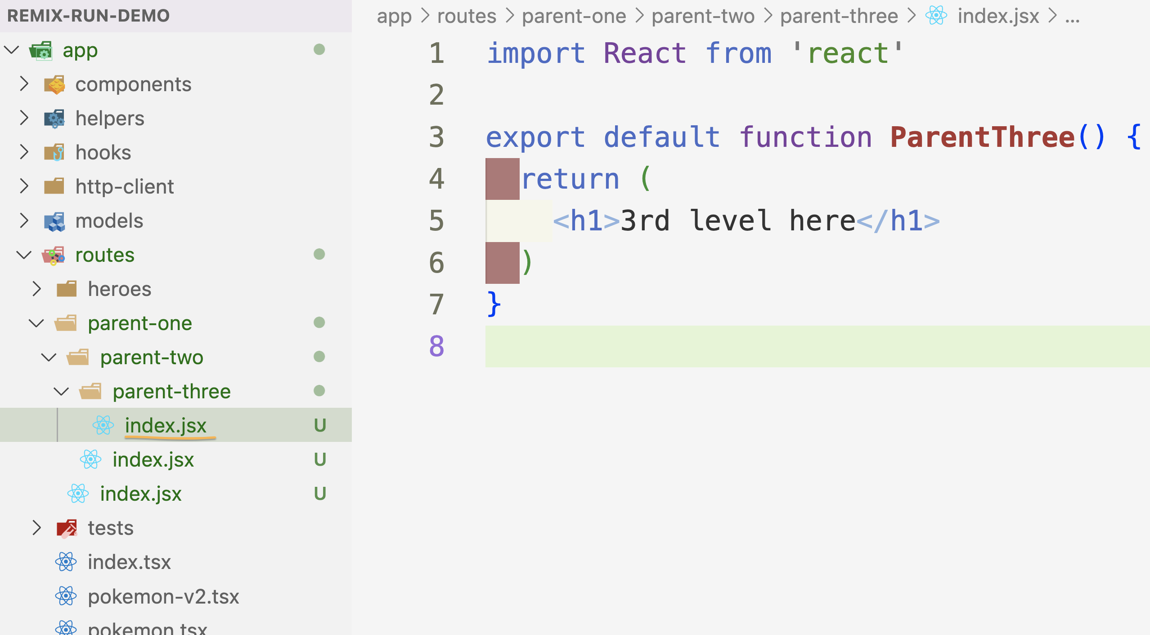
Notes:
Remix gives you the possibility of managing nested pages and components. We can create a file to handle a certain route and, at the same level in the file system, a folder with the same name.

Slide 11
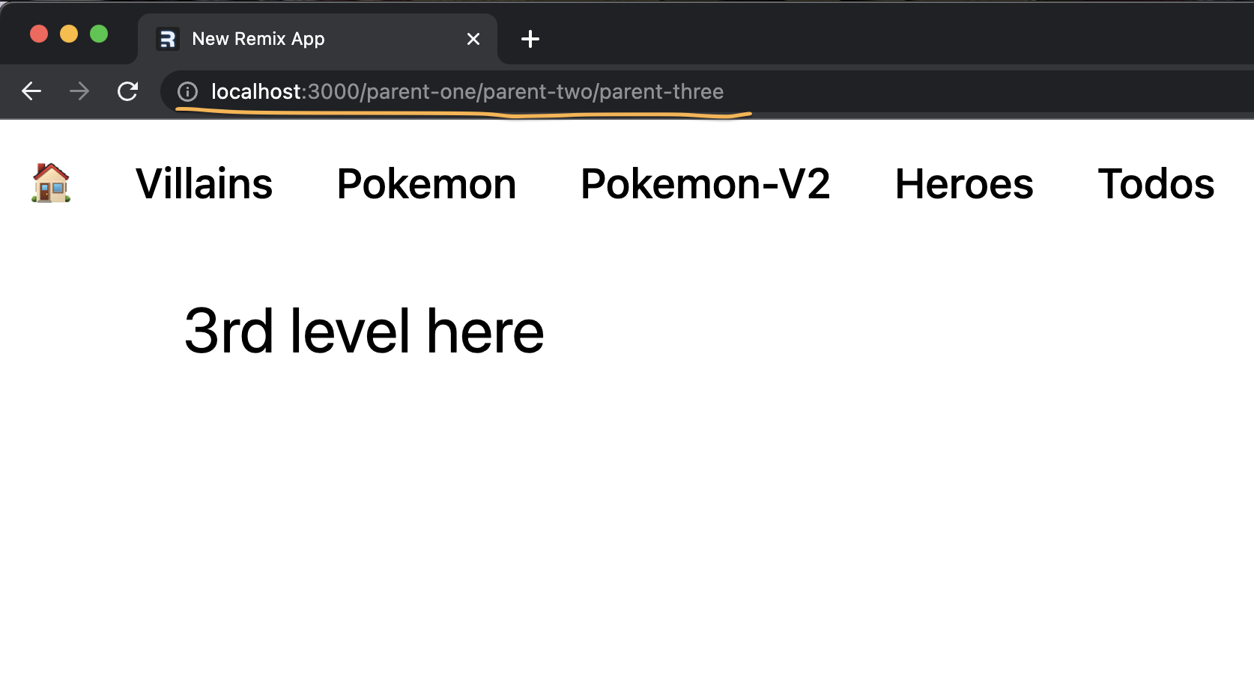
Notes:
All the files that we create inside that folder will be nested components of the parent route, instead of different pages.

Slide 12

Error Handling
Notes:
The Nested components itself bring also a benefit: if an error occurs while rendering a certain component, it doesn’t affect the other nested parts of the page.

Slide 13
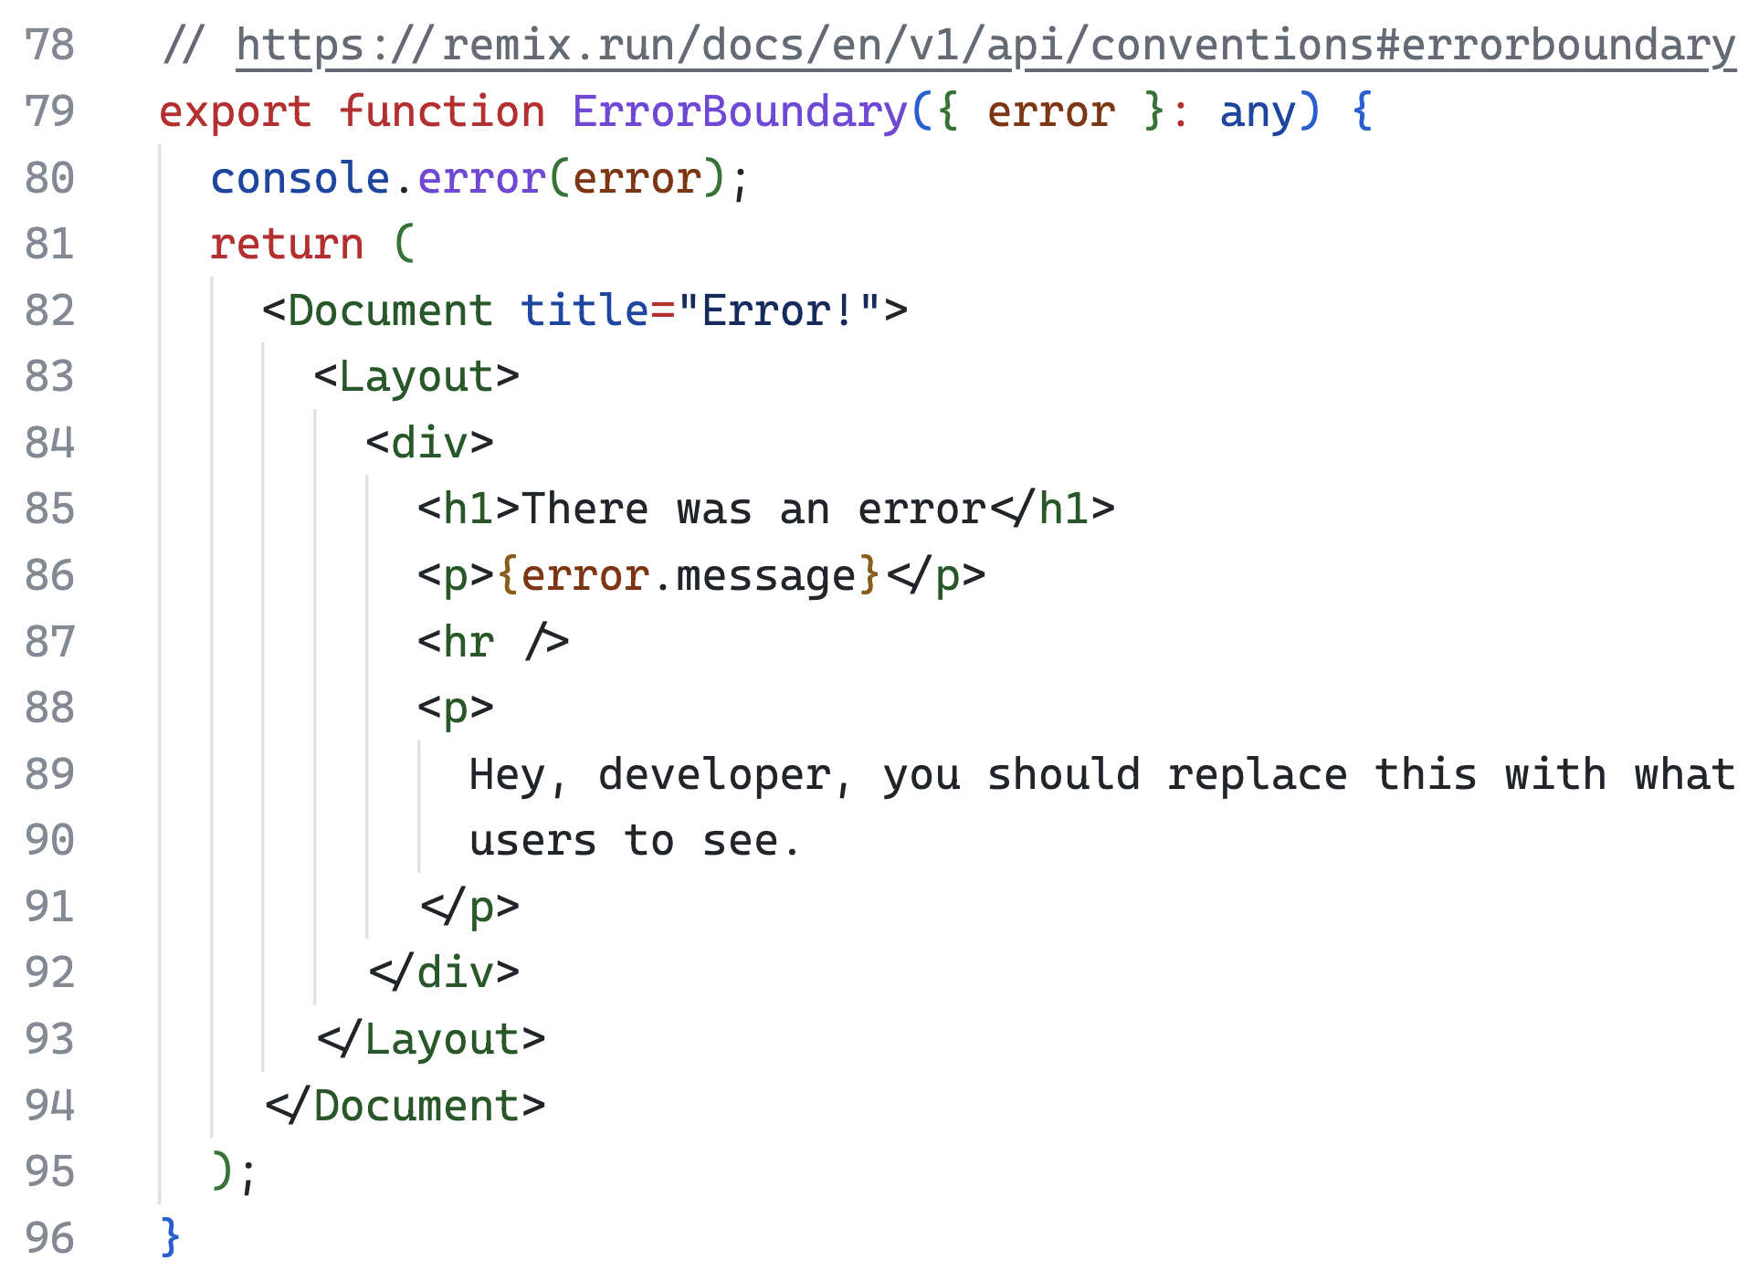
Error Handling
Notes:
So, we can encapsulate the error just in the section where it happened, instead of getting a general page error.

Slide 14
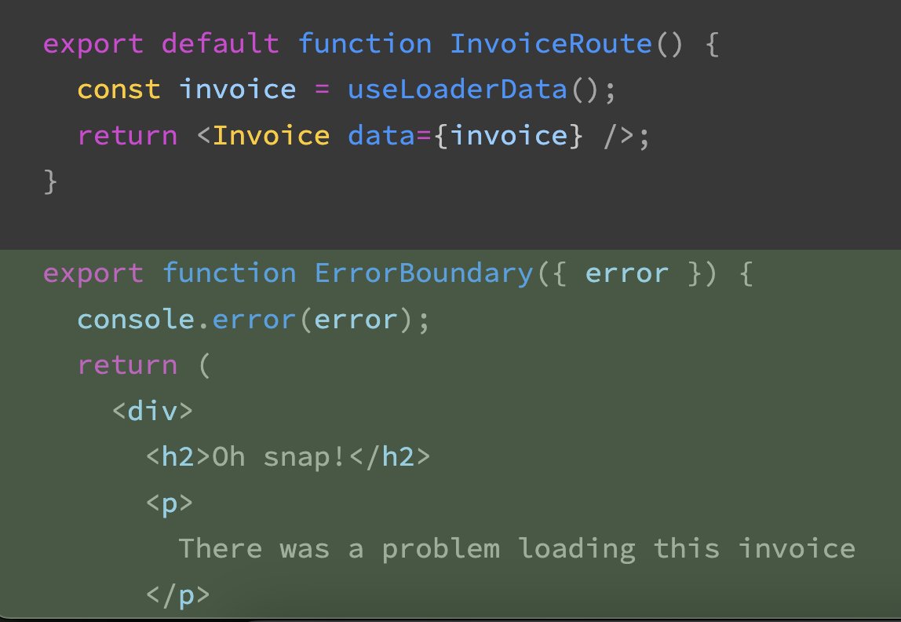
Routes Error Boundaries

Slide 15
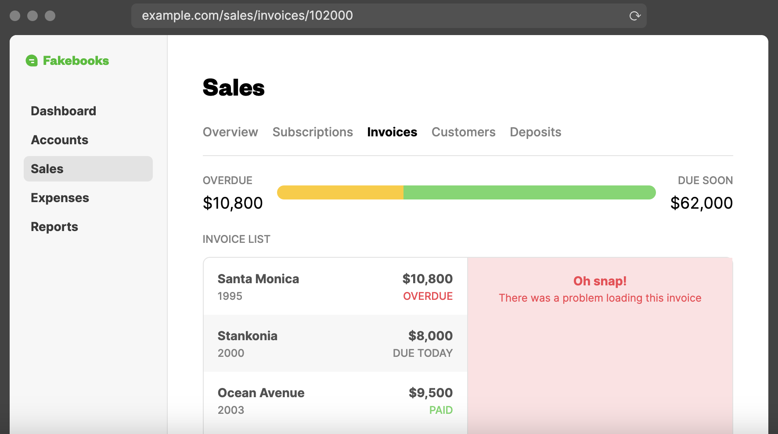
Notes:
If an error is thrown, client or server side, users see the boundary instead of the default component.

Slide 16
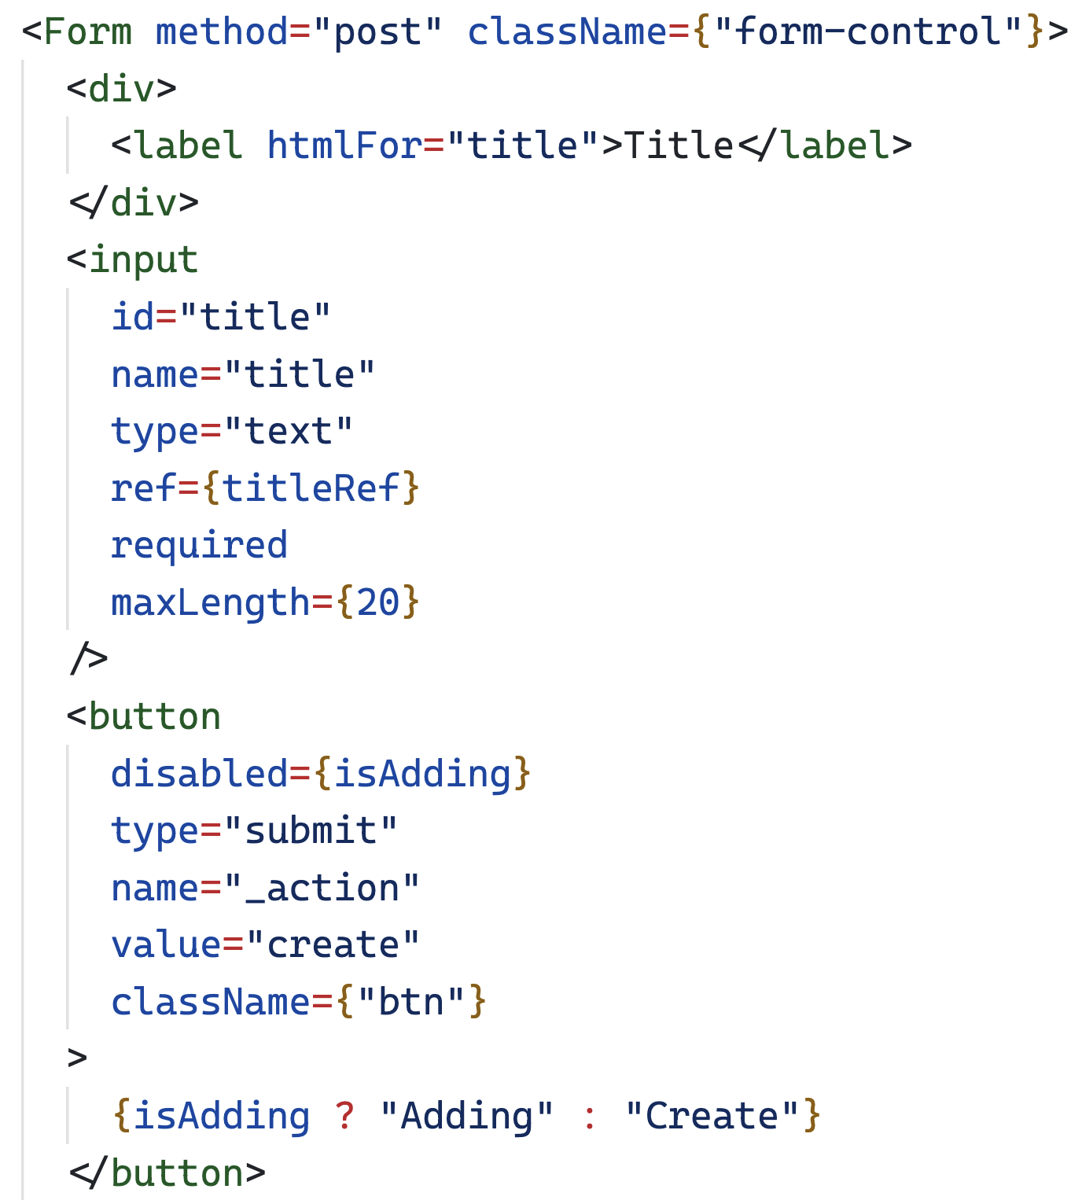
Notes:
Remix focuses on web standards. So Remix has its own form and it uses native methods (POST, PUT, DELETE, PATCH) to handle forms instead of using JavaScript for that and to keep the user on the SPA like experience without reloading the page. Just like with built in preventDefault on the form.

Slide 17
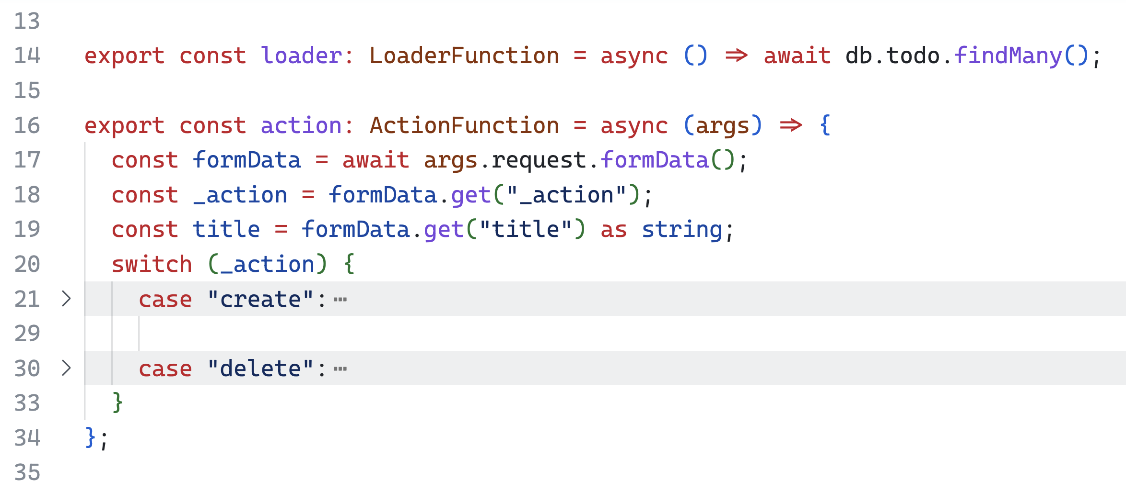
Server-side dynamic content
Notes:
Remix provides two different types of functions to create server-side dynamic content. The loader functions are used to handle GET HTTP requests in the server, mainly used to get data from different sources. The action functions monitor POST, PUT, DELETE, and PATCH requests, focused on data manipulation and modification.

Slide 18
No more loading spinners
with SSR you get fully interactive page
( loading . . . )
Notes:
Using SPA means that you have to wait for the server to load the data, in the meantime, you need to notify your users by giving them a loading spinner. With SSR you get the fully interactive page.

Slide 19
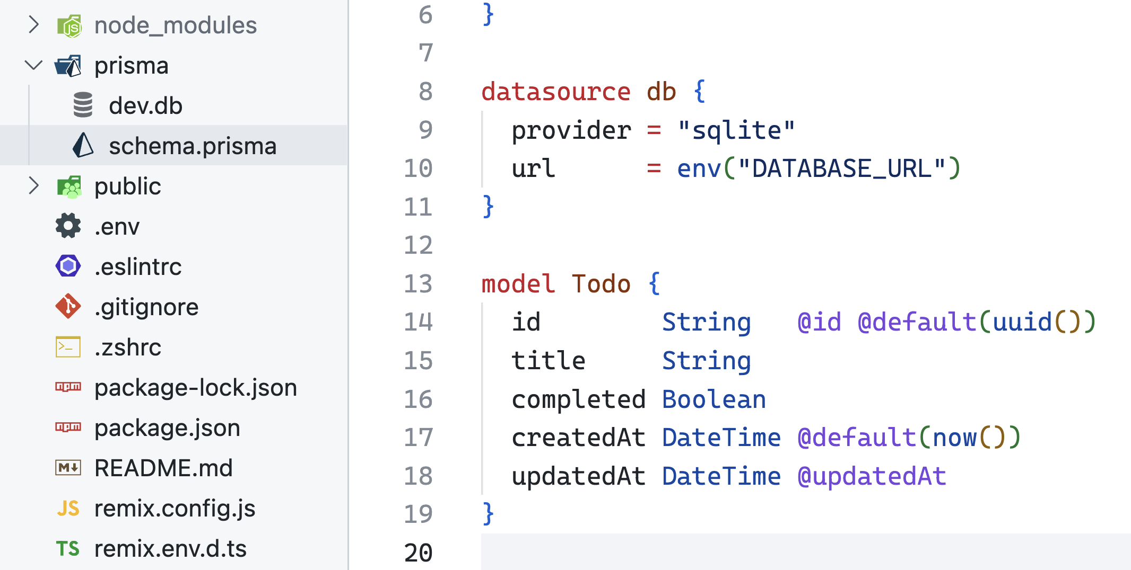
Integrations
Notes:
Working with databases has never been easier. With Prisma plus SQLite for local development or Supabase for a fast PostgreSQL prod app. Then Vercel for hosting.

Slide 20
Remix Stacks
Remix Stacks is a feature of the Remix CLI that allows you to generate a Remix project quickly and easily.
There are several built-in and official stacks that are full blown applications. You can also make your own.
Notes:
For sample projects, boilerplates, etc.

Slide 21

Tip of the iceberg
Notes:
Those features are just tip of the iceberg. There’s more but unfortunately, we don’t have much time.

Slide 22
What Are The Differences Between Remix And NEXT.js?
Notes:
We will identify similarities and differences here.

Slide 23
REACT BASED
Remix : React, Vue.js, Angular, and Svelte
NEXT.js: depends on React
Notes:
Remix community members have been working on different implementations using other frameworks, like Vue.js, Angular, and Svelte. NEXT.js depends on React, and there is no plan to change this at the moment.

Slide 24
SERVER-SIDE RENDERING
both Remix and NEXT.js offer server-side rendering (SSR)
Notes:
both Remix and NEXT.js offer server-side rendering (SSR) to generate the markup and content of our pages from the web server before sending it to the client.

Slide 25
Static site generation
NEXT.js offers static site generation (SSG)
Remix does not support SSG
Notes:
NEXT.js offers the possibility of pre-generating static pages and content at build time, using static site generation (SSG), while Remix doesn’t.

Slide 26
Stale while revalidate
Remix relies on the stale-while-revalidate caching directive (SWR)
NEXT.js stale-while-revalidate inside the getServerSideProps function
Notes:
To serve content as fast as possible, Remix relies on the stale-while-revalidate caching directive (SWR). NEXT.js also offers the possibility of working with stale-while-revalidate. Inside the getServerSideProps​ function

Slide 27
Client-side navigation
Remix uses HTML <link rel=“prefetch”>
NEXT.js via the <Link> component

Slide 28
EDGE Native (cdn)
Remix: Ready
NEXT.js: Ready
Notes:
Edge it’s like CDN but instead of just static sites, you can use your dynamic web apps to be deploy in different parts of the world.

Slide 29
Unhandled errors
Notes:
Let’s see an example of Unhandled errors

Slide 30
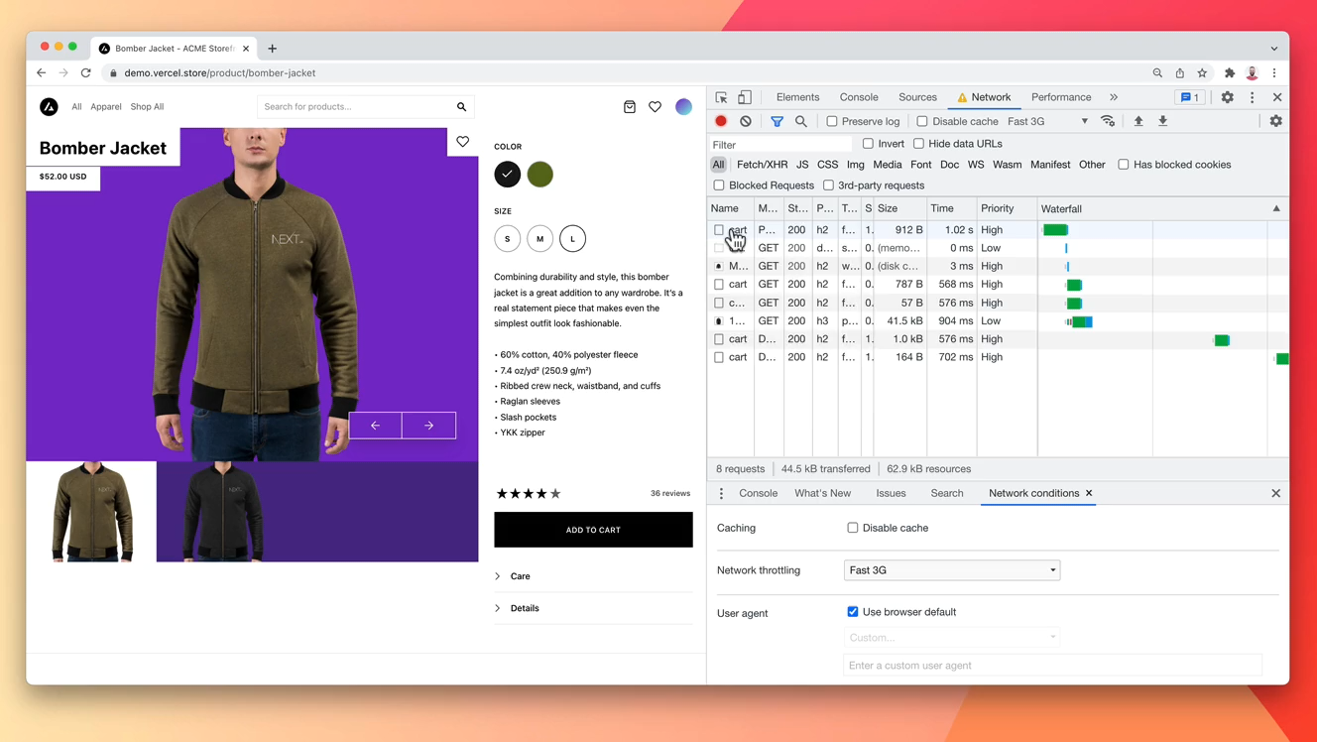
Notes:
Here is NEXT.js, nothing happens and this is a default user experience.

Slide 31
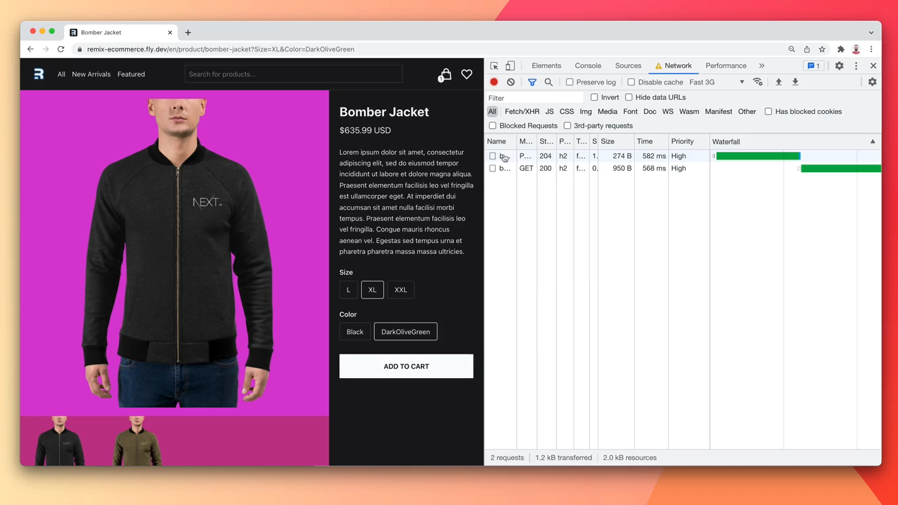
Notes:
Here is Remix, Remix handles every error around data and rendering in your app, even errors on the server.

Slide 32
interruptions

Slide 33
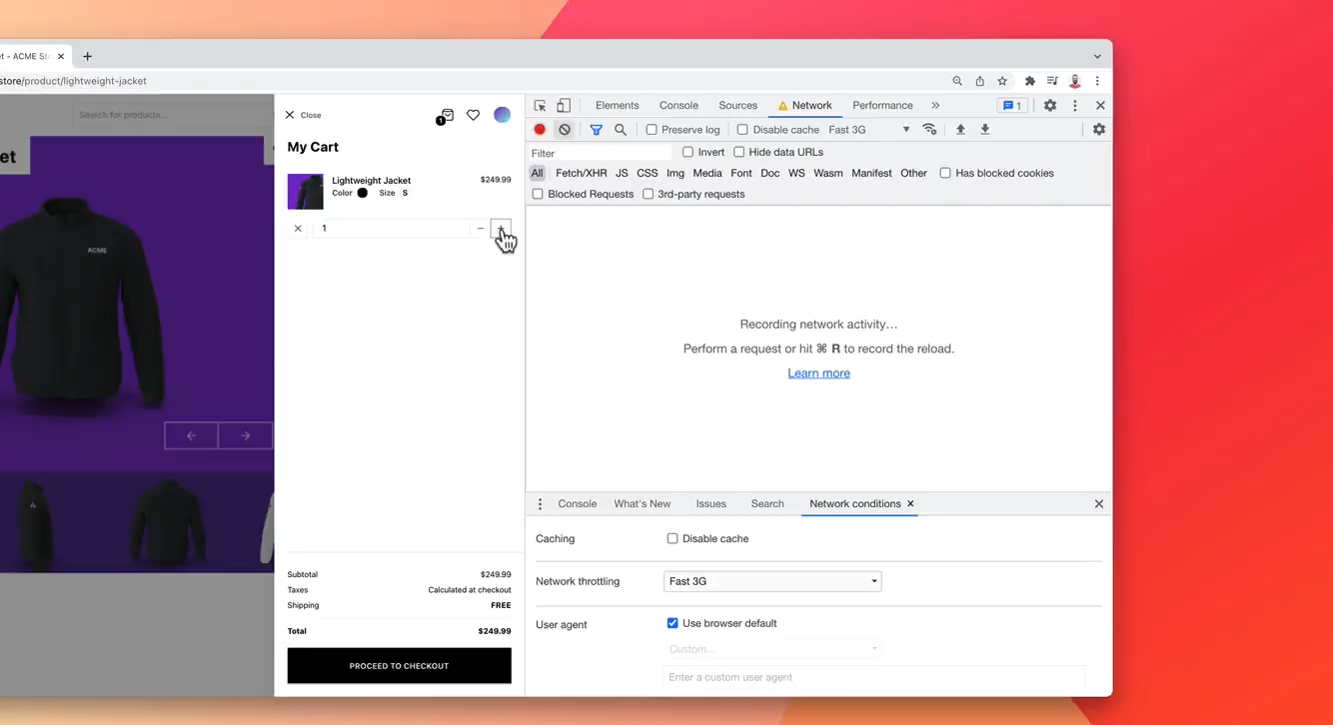
Notes:
NEXT.js doesn’t manage race conditions, interruptions, or revalidation, so the UI is now possibly out of sync with the server

Slide 34
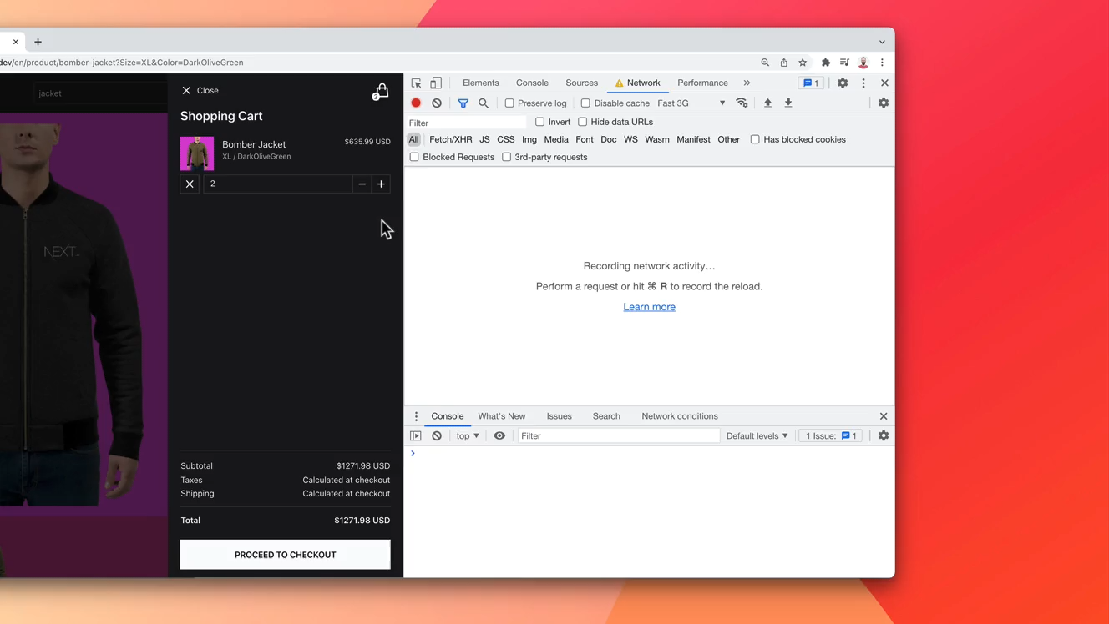
Notes:
Here’s Remix. You can see Remix cancels the request on interruptions and revalidates the data after the POST completes. This ensures that the UI across the entire page (not just this form) is in sync with whatever changes your form just made with the server.

Slide 35
Getting started

Slide 36
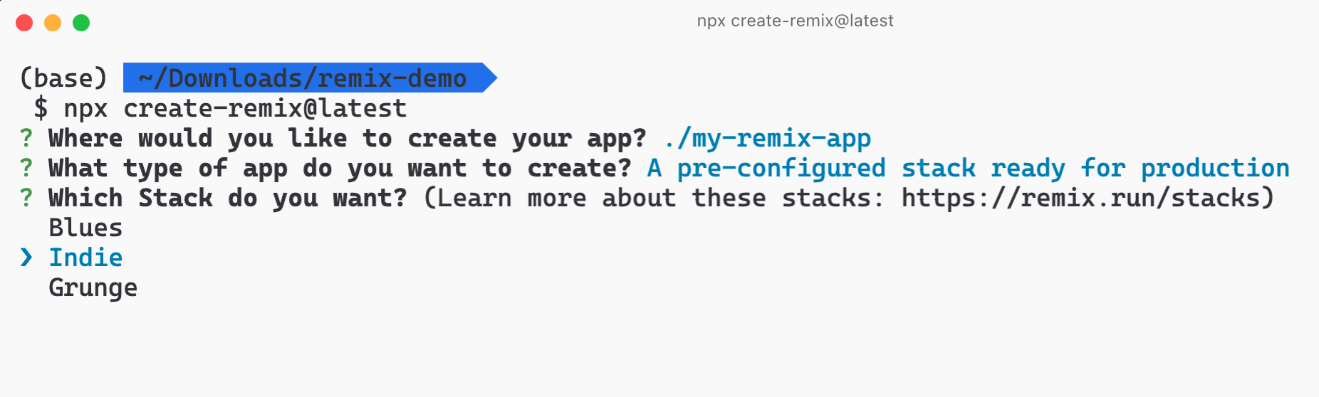
Notes:
There are templates here, I'll describe what
these are. Blues, indie, and grunge.
So, the Blues stack deploys to Fly; it has authentication, Cypress, Tailwind, supports Postgres, and has a local database running in Docker there.
The Indie stack is very similar to blues; instead of Postgres, it uses SQLite and no Docker.
And the Grunge use DynamoDB as the persistence layer. It deploys on AWS.

Slide 37
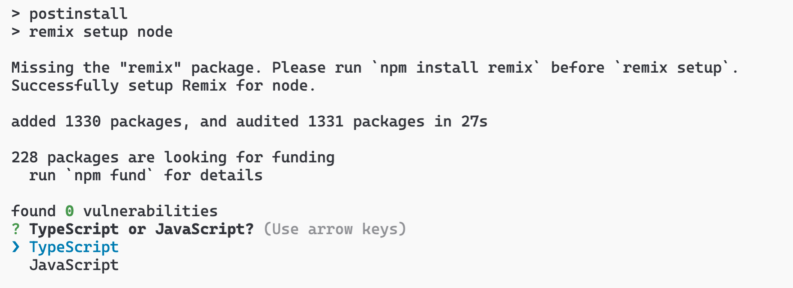

Slide 38
demo

Slide 39
Security
remix-auth-form
or
remix-auth-auth0
Notes:
A Remix Auth strategy to work with any form.
The Auth0 strategy is used to authenticate users against an Auth0 account. It extends the OAuth2Strategy.

Slide 40
Docs:
https://remix.run/docs
Sample repo:
https://github.com/webmasterdevlin/remix-run-demo
Notes:
Remix became open-source not so long ago, but it already has a very active community collaborating and creating projects following the web standards.

Slide 41

Docs:
https://remix.run/docs
Sample repo:
https://github.com/webmasterdevlin/remix-run-demo
Notes:
And recently Remix has been acquired by Shopify. So, Remix will not be used in more than 2 million e-commerce sites across the globe.

Slide 42

Notes:
Thank you sponsors, if not for you this wouldn’t possible.

Slide 43

This is the way @DevlinDuldulao
Merci de votre attention
Notes:
And then please submit your feedback in this QR Code. Merci-devotra-tension (Merci de votre attention)

Slide 44


